Slide 1
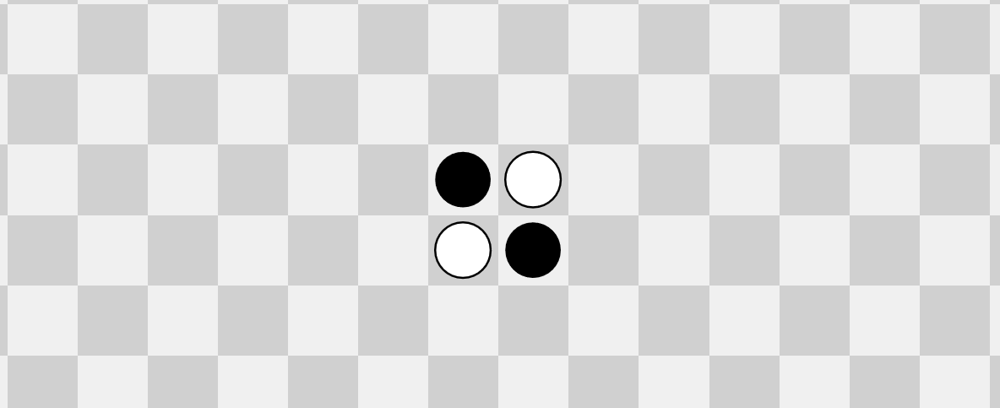
The Othello game on an n*n board is PSPACE-complete
May 6, 2021
Niels Saurer

Slide 2
Othello
Two players: Black and White
8*8 board
Markers ( , ) are added to the board each turn
Black is first to move
A move “jumps over opponent’s markers and converts them”
If a player can’t make a move, he passes this move
The game ends if both players pass
The winner is the player with more remaining markers on the board

Slide 3
Generalized Othello
8*8 board → n*n board
Question: Can Black win?
Perfect play by White
Given initial board
Notes:
From here on out, Othello = Generalized Othello

Slide 4
Othello is PSPACE-complete
Pick L = “Generalized Geography” (GG for short)
PSPACE
Previous papers
This paper
L
Othello

Slide 5
Generalized Geography (GG)
Visited
Previously visited
Unvisited and possible option
Unvisited, but illegal option
∃ and ∀
Question: Can ∃ win?
∃
∀
∃
∀

Slide 6
Othello is in PSPACE
NP: non-deterministic Turing Machines (NTM)
PSPACE: alternating Turing Machines (ATM)
NTM
ATM
∃
∃
∃
∃
∀
∀
∃
∃
∃
∀
NP, PSPACE: Limit depth to polynomial of input length

Slide 7
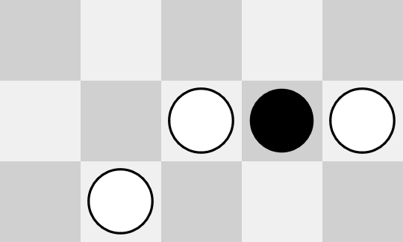
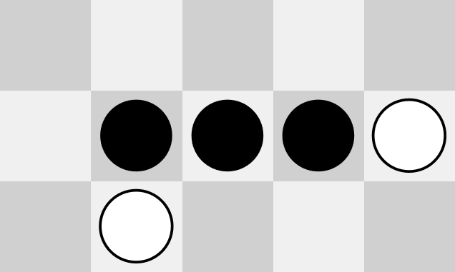
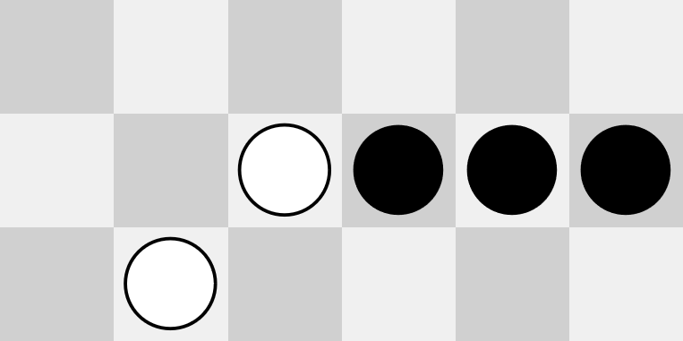
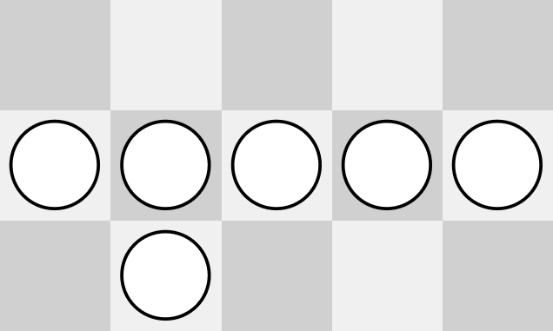
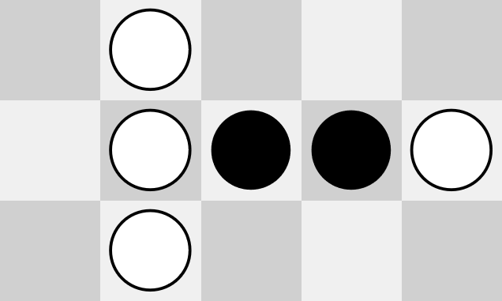
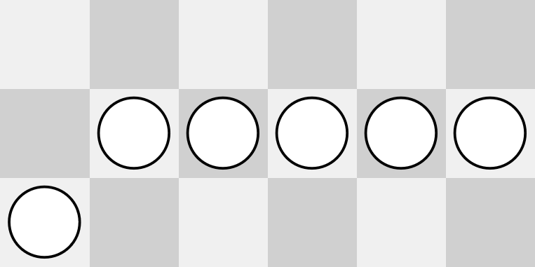
Othello is in PSPACE
Informal proof:
Game takes at most $2n^{2}$ moves to finish
Game tree like ATM tree
⇒ polynomial-time ATM
⇒ Othello $∈$ PSPACE$_{∎}$
∃
Black’s move
∀
∀
White’s move
…
Black’s move
X
X

Slide 8
Othello is PSPACE-hard
GG → Othello
Provide TM A:
Polynomial-time
Given GG problem ggP, constructs Othello problem oP := A(ggP), s.t.
ggP $∈$ GG oP $∈$ Othello
ggP $∉$ GG oP $∉$ Othello
“
“
A
“
“
A
∃ cannot win
Black can win
∃ can win
Black cannot win

Slide 9
Reduction
We want:
GG simulation
Mechanism to ensure GG is simulated
GG simulation:
Node-by-node translation to Othello configurations
Simulation enforcement:
Player doesn’t simulate $⇒$ “make” other player win

Slide 10
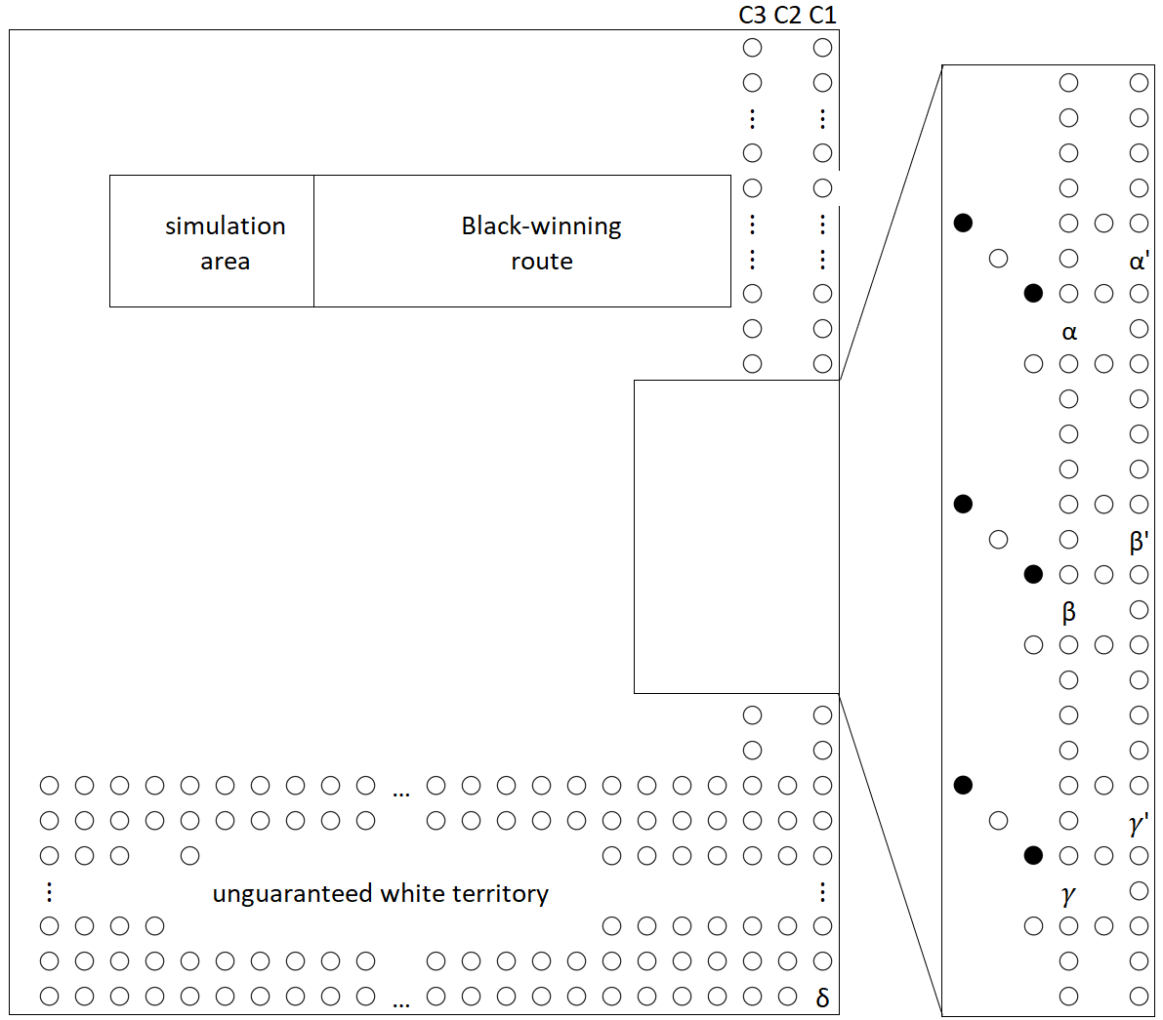
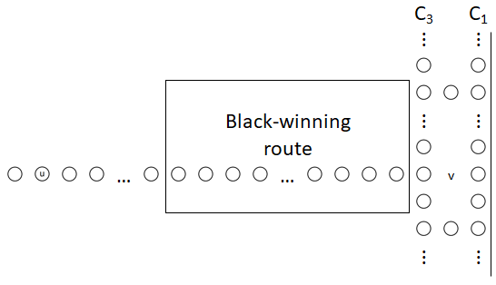
Board template
Black-winning line
critical marker
Normal play:
Black normal play: convert a critical white marker to black
White normal play: convert all critical black markers to white
Why is this important?
Forces both players to play by the “reduction rules”

Slide 11
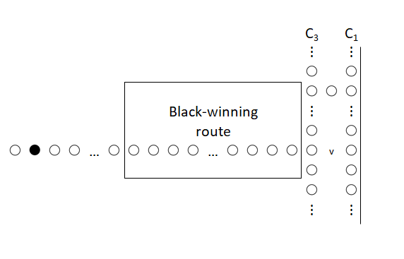
Reduction Referee
Black normal play: convert a critical white marker to black
White normal play: convert all critical black markers to white
What if White does not play normally?
= black critical marker remains

Slide 12
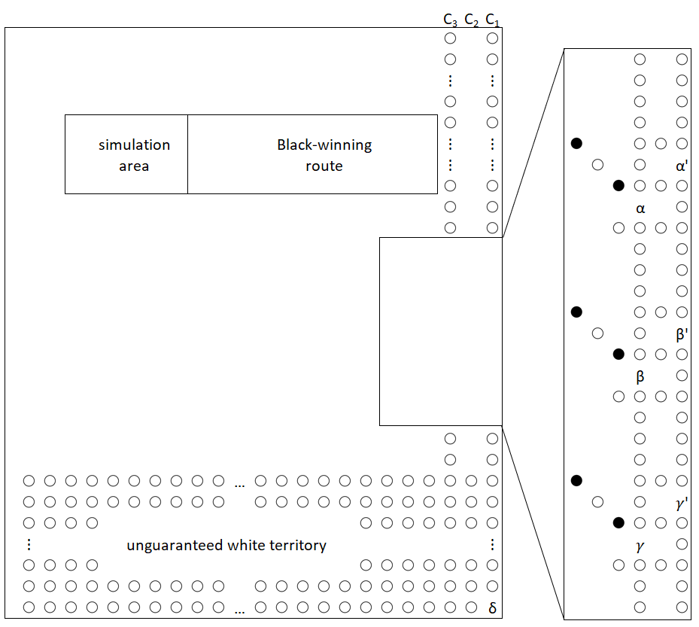
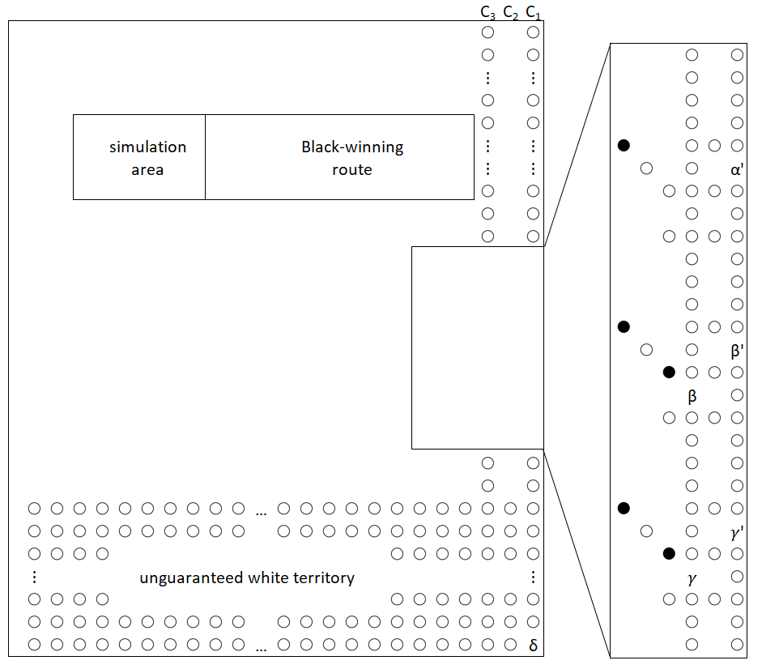
Reduction Referee
White’s turn

Slide 13
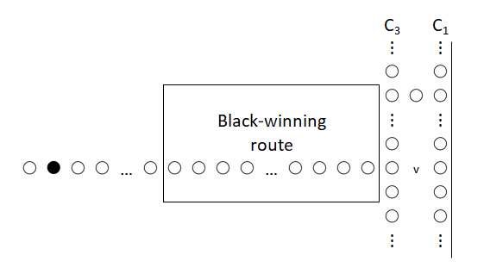
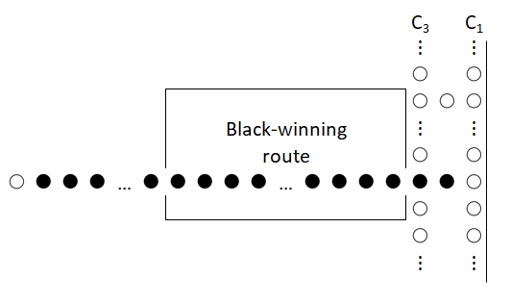
Reduction Referee
Black’s turn

Slide 14
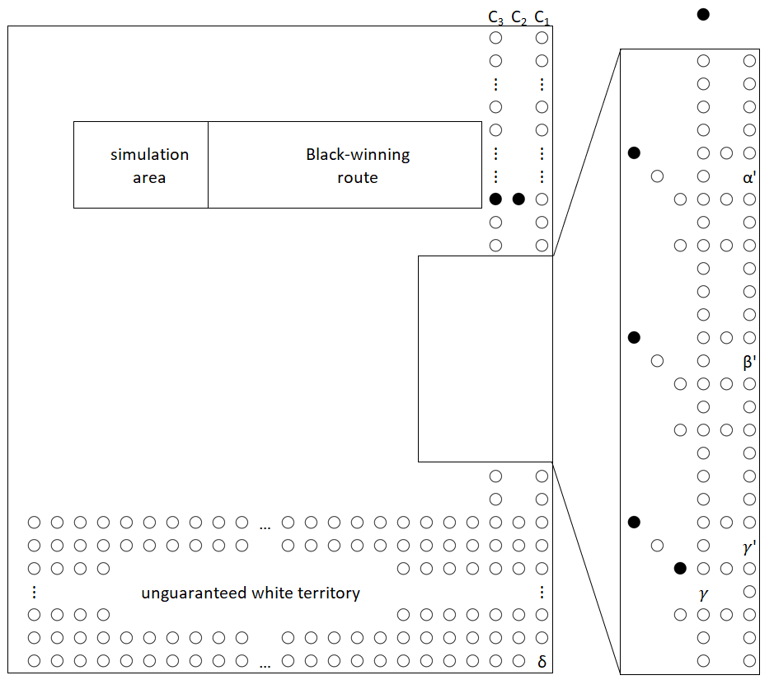
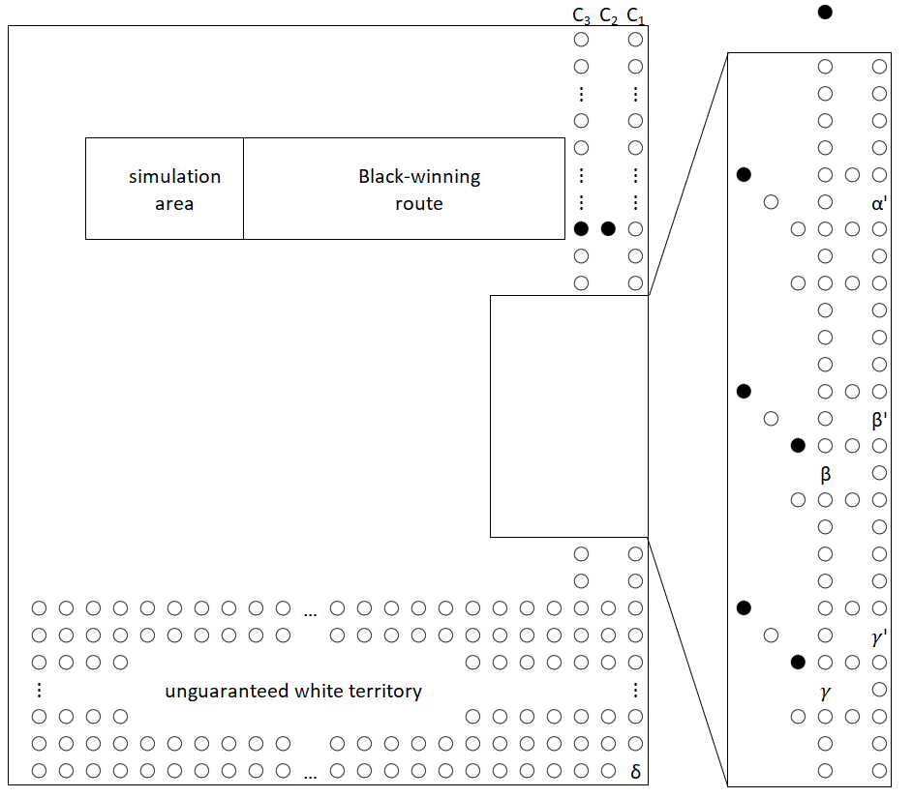
Reduction Referee
White’s turn

Slide 15
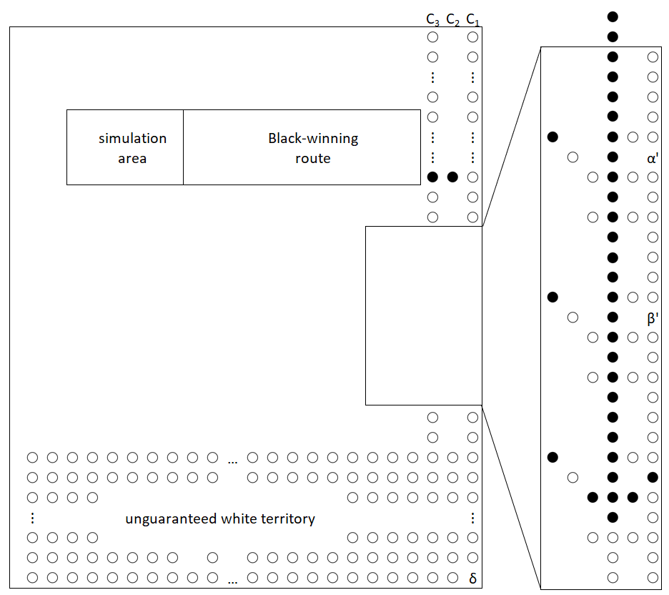
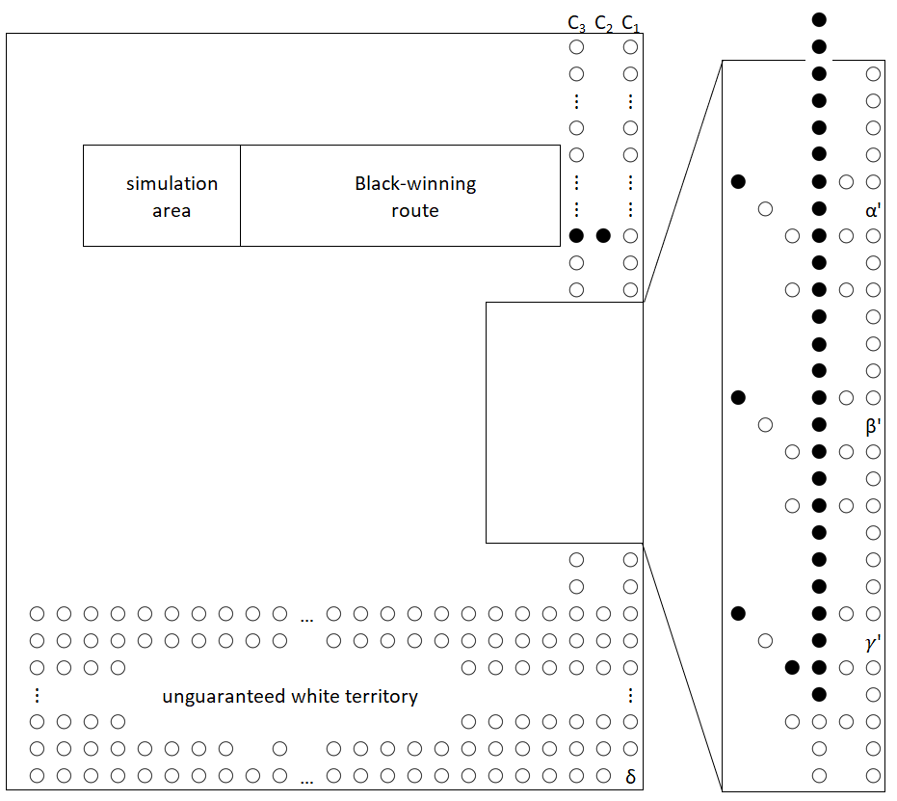
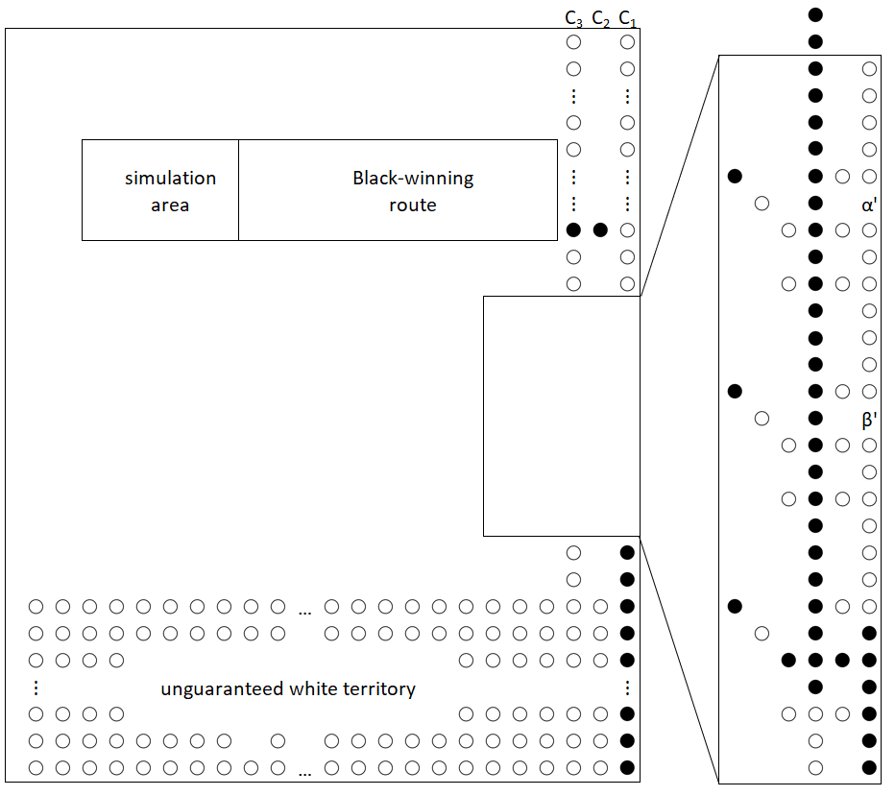
Reduction Referee
Black’s turn

Slide 16
Reduction Referee
Black normal play: convert a critical white marker to black
White normal play: convert all critical black markers to white
What if Black does not play normally?
= no critical black marker after turn

Slide 17
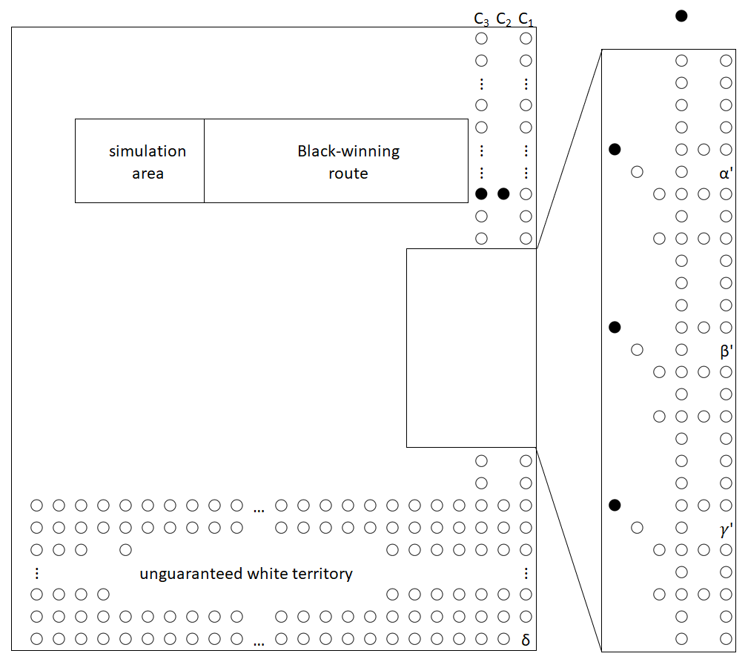
Reduction Referee
White will manage to close all weak points α, β, 𝛾
Black can only infiltrate white territory through α, β, 𝛾
Hence white guarantees itself the territory and wins the game

Slide 18
Reducing GG node-by-node
Specialized GG formulation: bipartite graph & only 3 types of nodes (still PSPACE-complete!)
G = X $∪$ Y is especially useful: ∀ plays in X, ∃ in Y
Type 1
Type 2
Type 3
Focus on Type 2 nodes in X

Slide 19
Reducing Type 2 in X
Requirements:
Entry possible from both incoming edges & redirects to same output
Revisitation leads to losing
Who loses?
∀, because node in X
Type 2

Slide 20
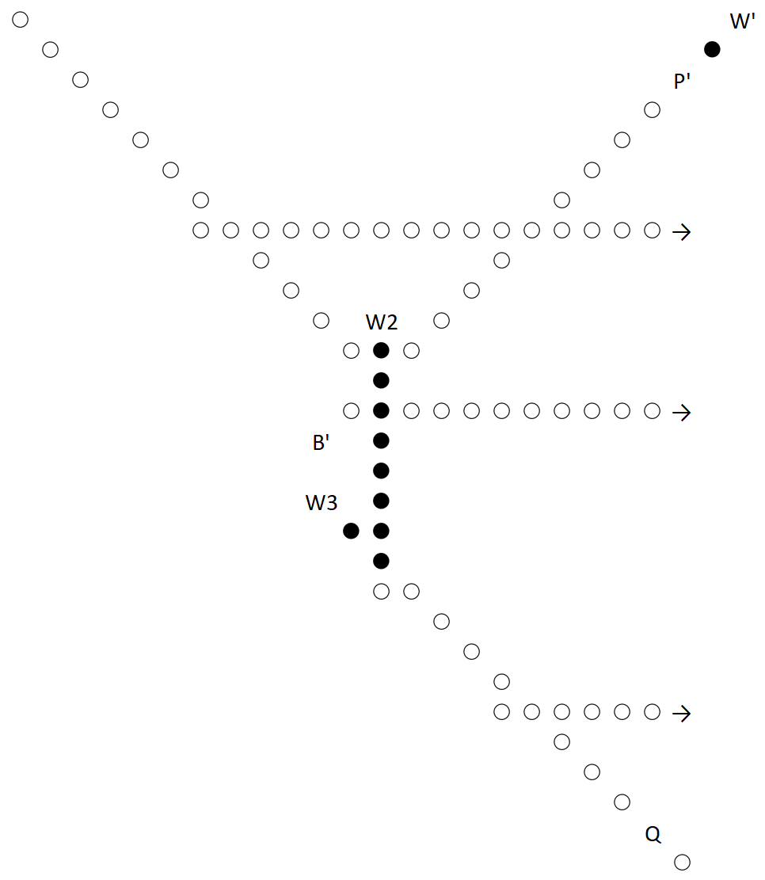
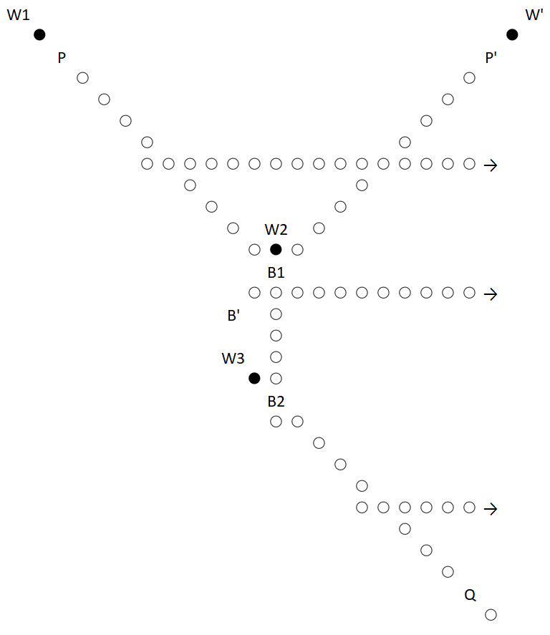
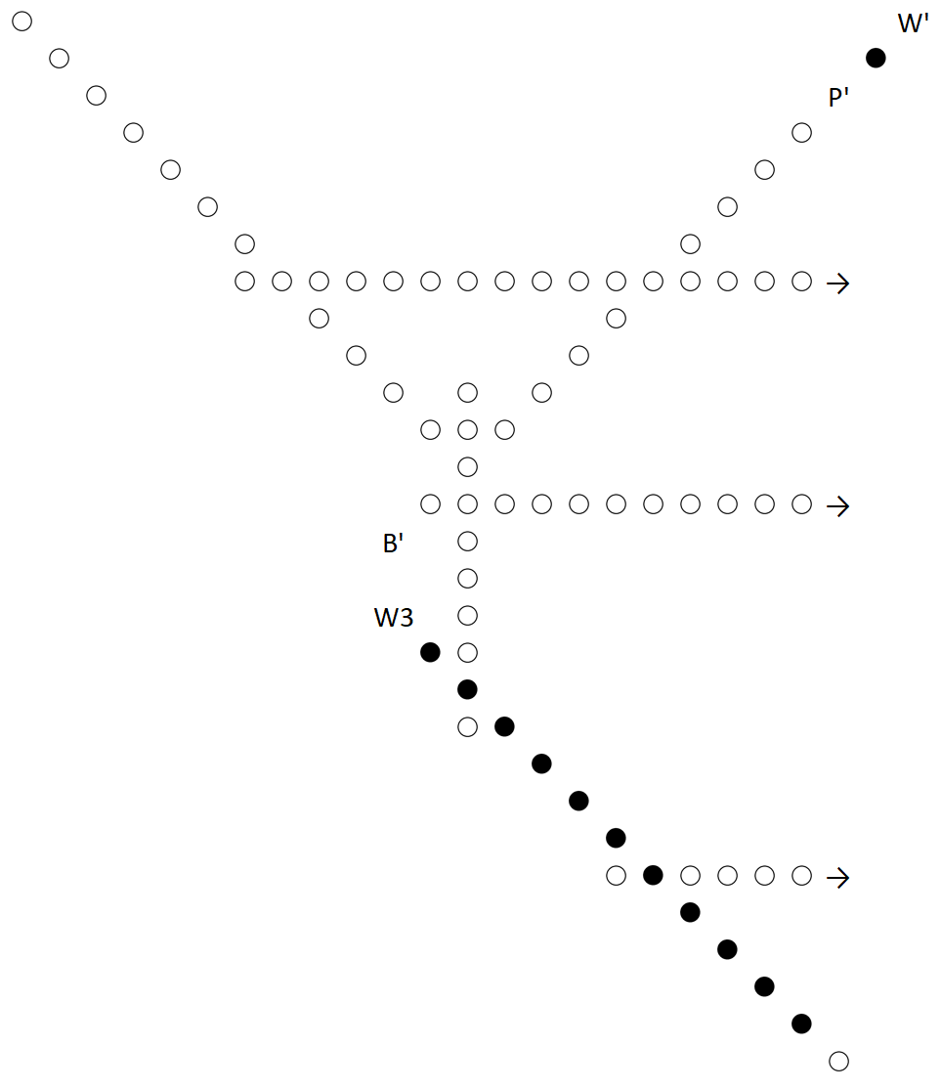
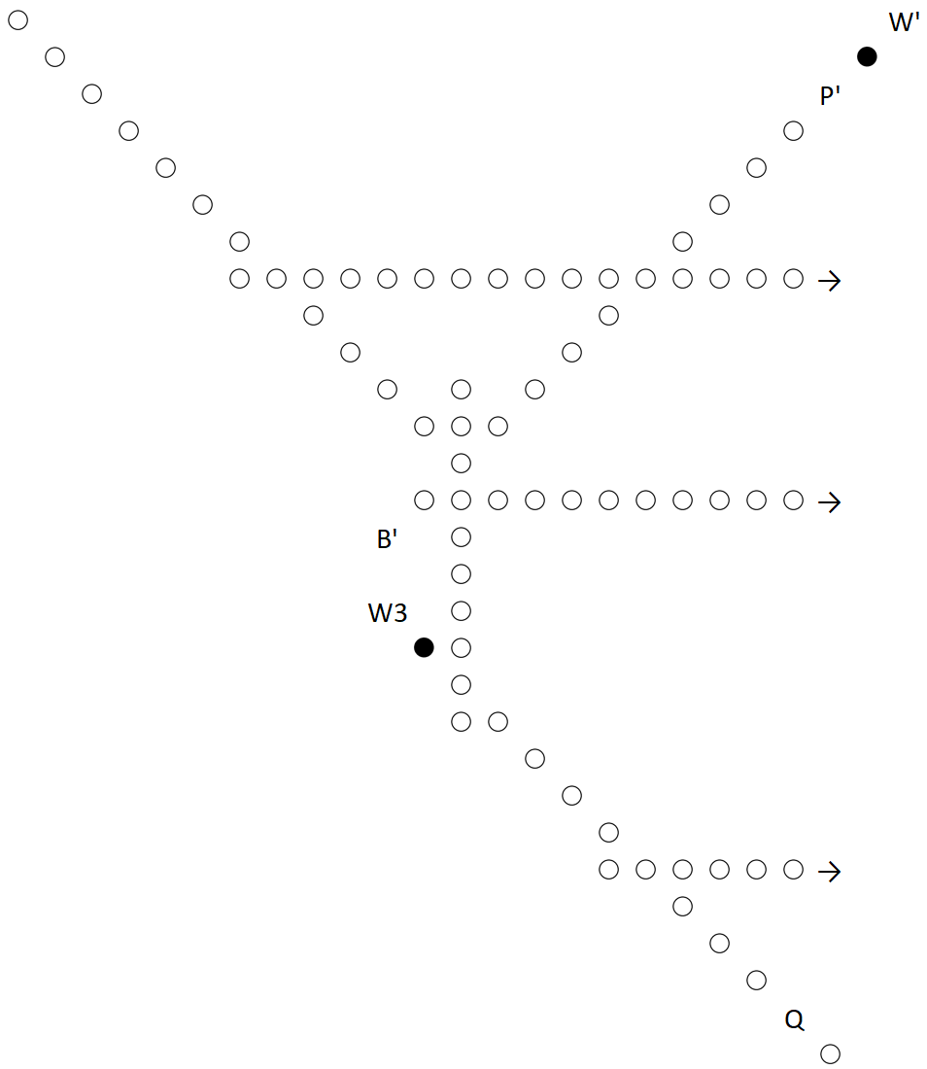
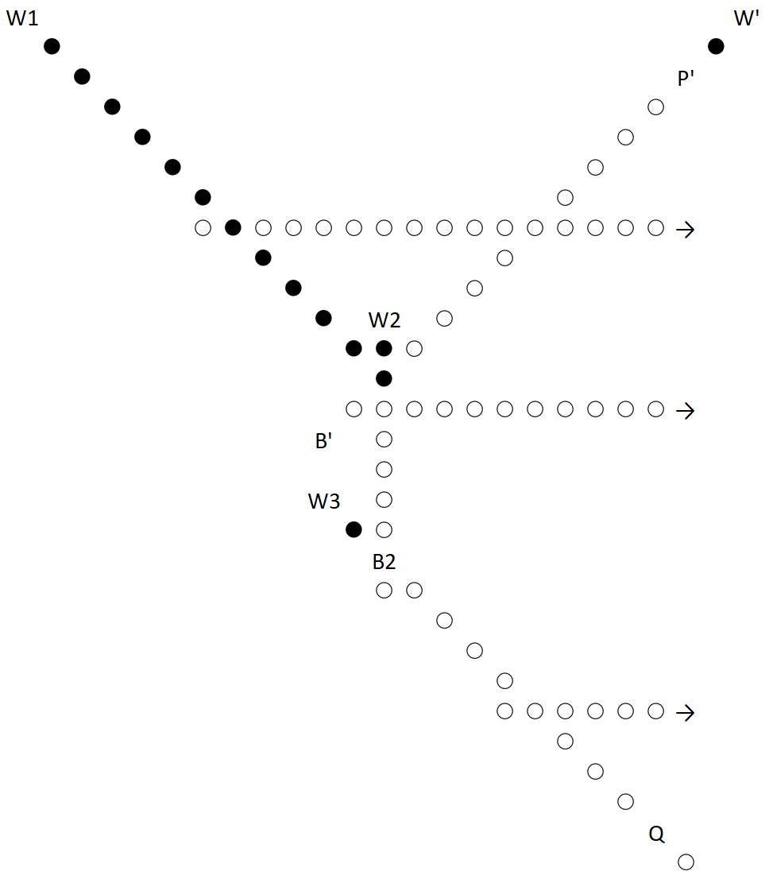
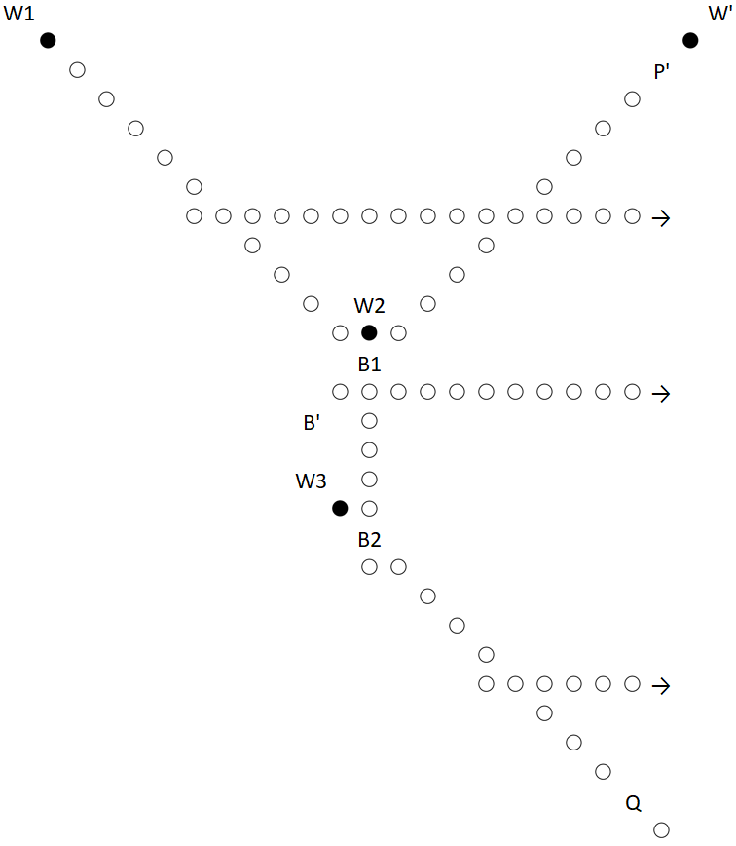
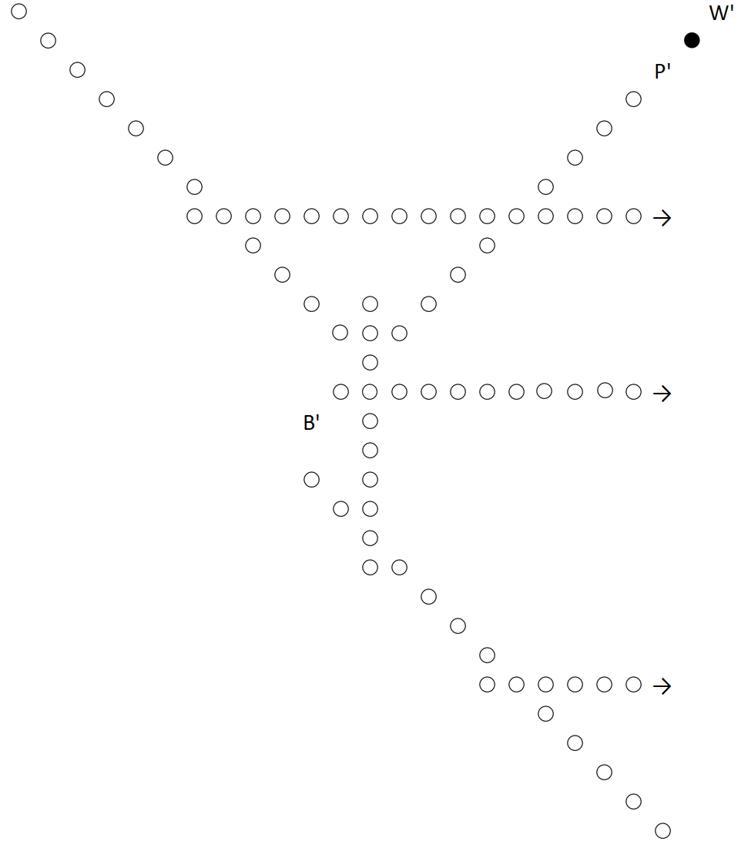
Reducing Type 2 in X
Configuration is activated by white placing a marker on P or P’
Let’s assume P
Because of normal play, the following is guaranteed:
Black on B1
White on W1
Black on B2
White on W2
Black on Q
White on W3

Slide 21
Reducing Edges
Match Q with P or P’
Also how configuration is activated in the first place!
… but how is the first configuration activated?
Type 2
Y
X

Slide 22
Special Entry Node e
GG: (G, e) graph G = X $∪$ Y e = initially visited node
Without loss of generality:
e is of type 3 and in X
Othello:
Configuration starts out activated, i.e. with white marker
Now our reduction is done!
∃ can win in GG $⇒$ Black can win in Othello
∃ can’t win $⇒$ Black forced to revisit node & lose.

Slide 23
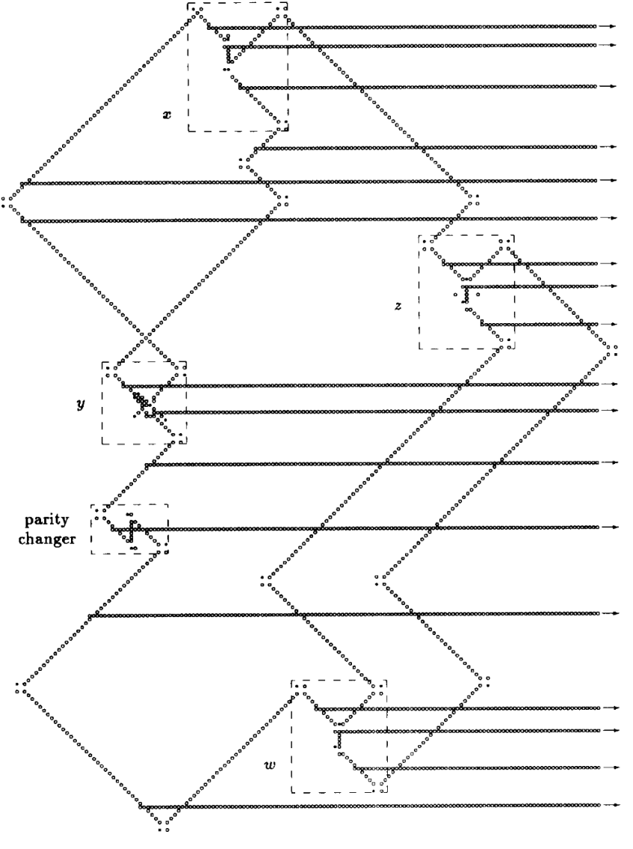
Complete Reduction

Slide 24
Thanks for your attention!

